Slide 1
Applied Time Series-Based Load Forecasting: A Comparative Study
Master Thesis
Bhavay Singhal
Matriculation Number: 5126210
13 January 2026
Supervisor: Ms. Jing Zou
Professor: Dr. Ostap Okhrin

Slide 2
Introduction

Slide 3
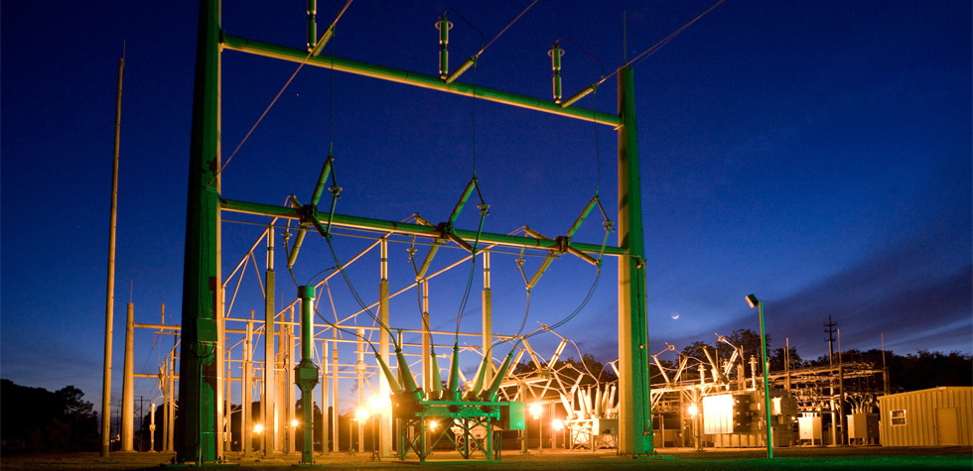
Critical Role of Power Utilities
Generate
Transmit
Distribute
Maintain
Source: International Energy Forum (IEF, 2026)

Slide 4
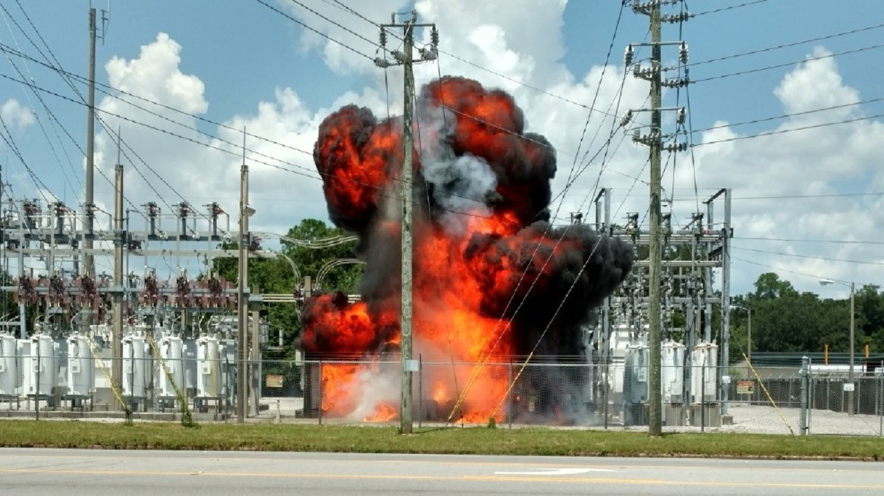
Motivation for Load Forecasting
Load imbalance
Supply > Demand
Supply < Demand
Storage??
Source: https://weartv.com/news/local/no-injuries-in-transformer-explosion

Slide 5
Challenges in Modern-Day STLF
Literature Insights

Slide 6

General Challenges in STLF
Unpredictable Explanatory Variables
Non-Linear Patterns
Rapid Fluctuation
High Volatility
Data Scarcity [Tsoumplekas et al. (2024)]
Source: www.vecteezy.com

Slide 7
Global Energy Forecasting Competition (2012)
Dr. Tao Hong, Industrial & Systems Engineering (UNCC)

Slide 8
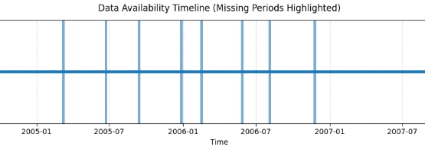
GefCom 2012: Load Forecasting in Smart Grids
20 Zonal Levels
4.5 years training
Hourly Temperature
8 Missing Periods
Horizon: 2008/7/1 to 2008/7/7
Code & Dataset Files: https://github.com/bhavay1998/Gefcom-2012/tree/main

Slide 9

Project’s Goals
Compare traditional time series models
Fill-in Missing Periods
Realistic Constraints [Tsoumplekas et al. (2024)]
30% improvement over Benchmark
Source: www.shutterstock.com

Slide 10
Exploratory Data Analysis
Observed Trends

Slide 11
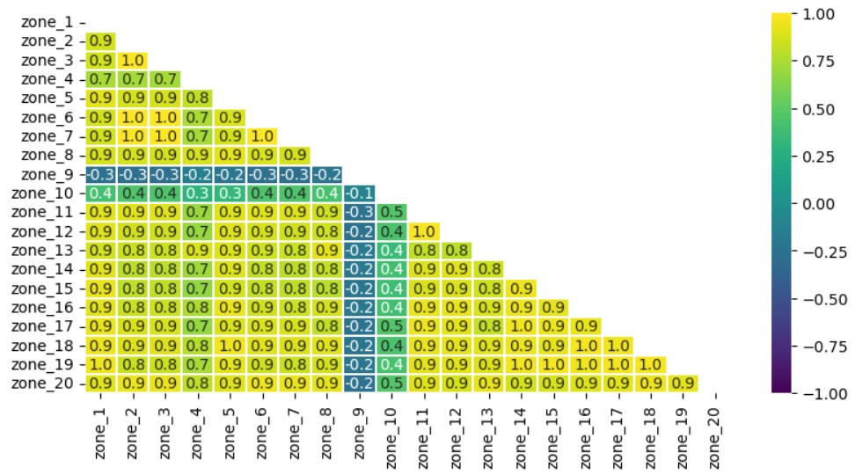
Zonal Correlation

Slide 12
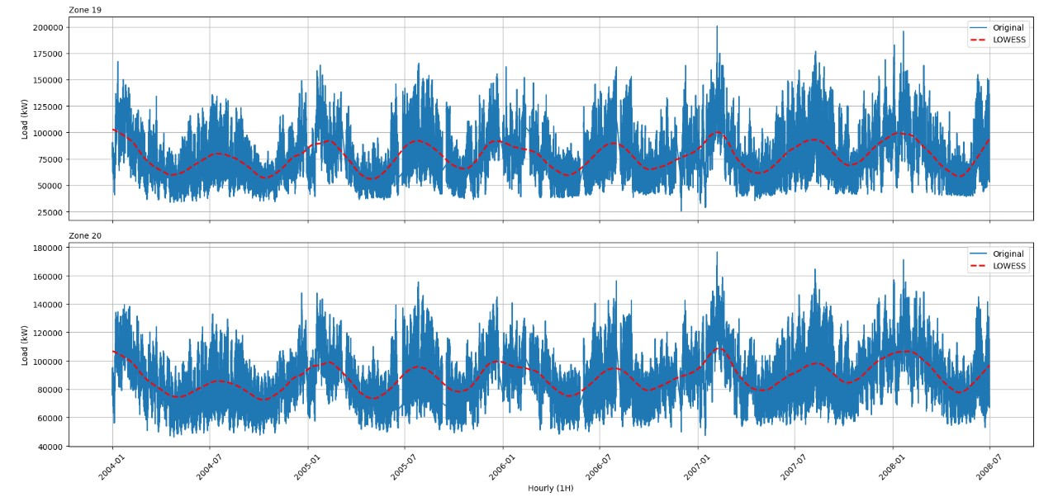
Load Movement

Slide 13
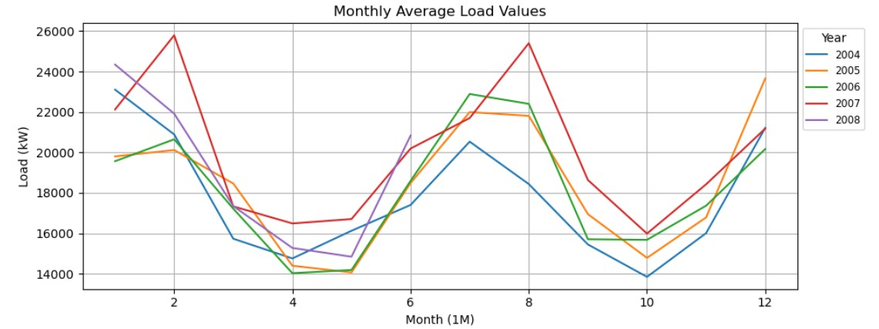
Average Monthly Load (Zone 1), by Year

Slide 14
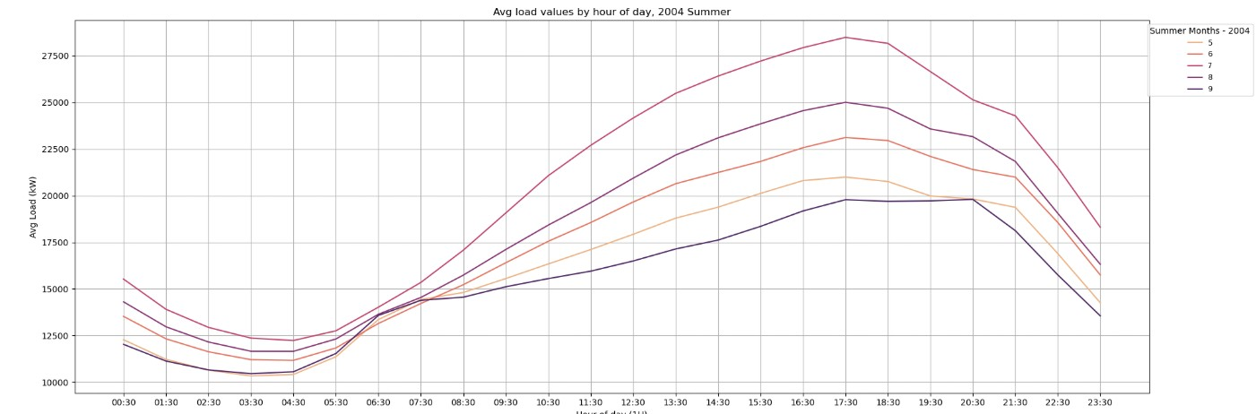
Avg Hourly Load Distribution, Summer (Zone 1 - 2004)

Slide 15
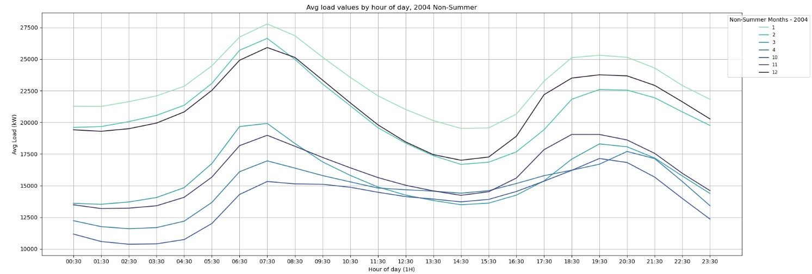
Avg Hourly Load Distribution, Non-Summer (Zone 1 - 2004)

Slide 16
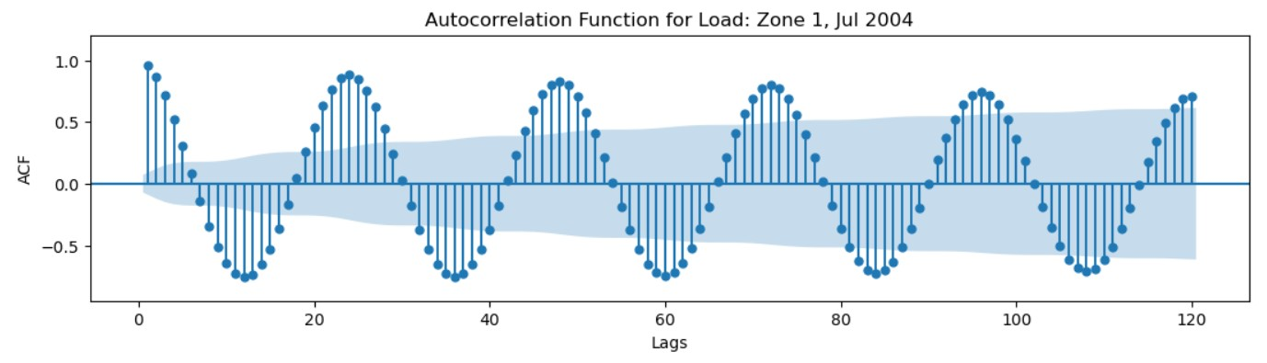
ACF (Zone 1 – 2004 July)

Slide 17
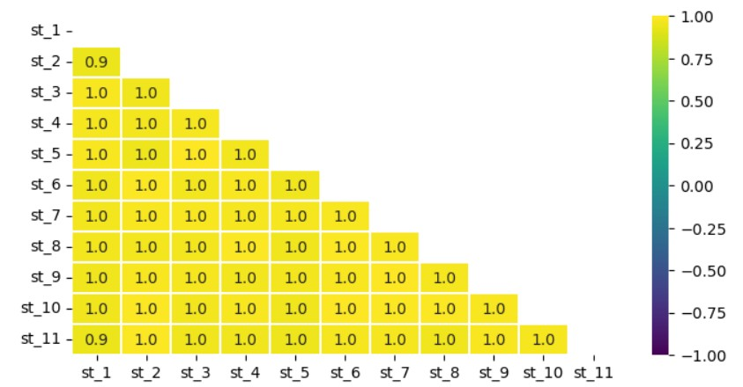
Correlation – Weather Stations

Slide 18
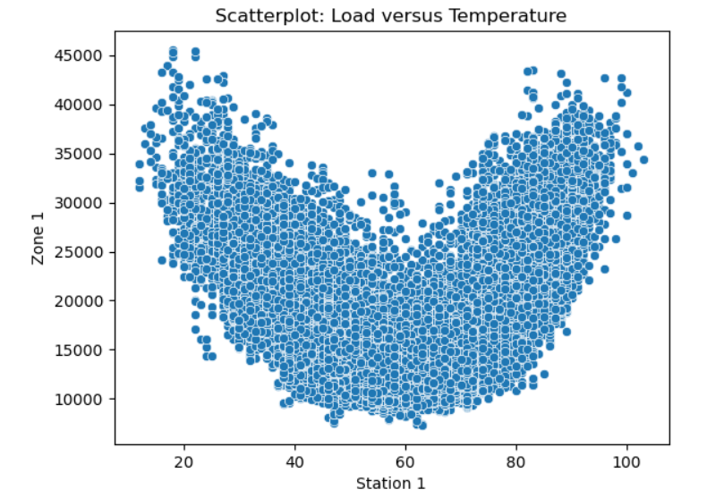
Load – Temperature Relationship

Slide 19
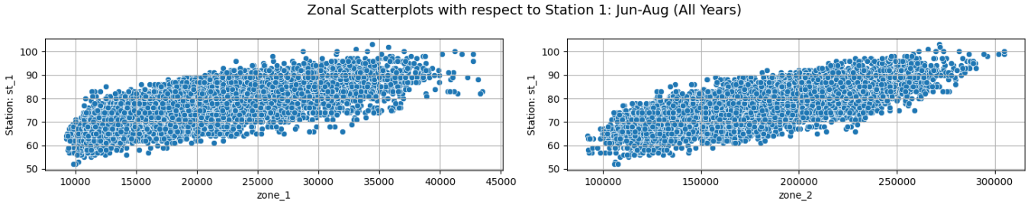
Load – Temperature Relationship (Summer)

Slide 20
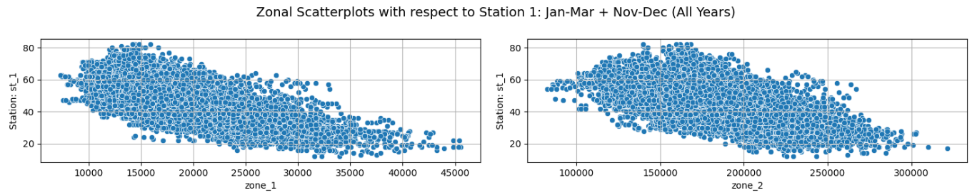
Load – Temperature Relationship (Non - Summer)

Slide 21
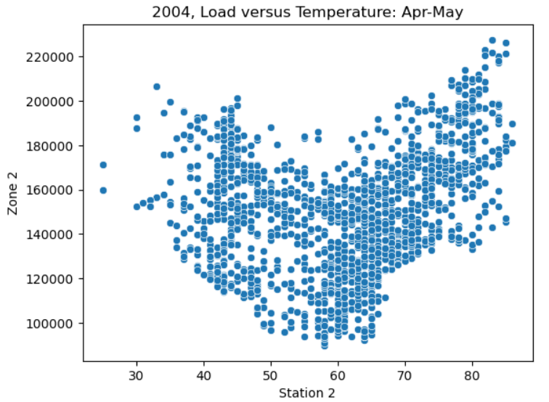
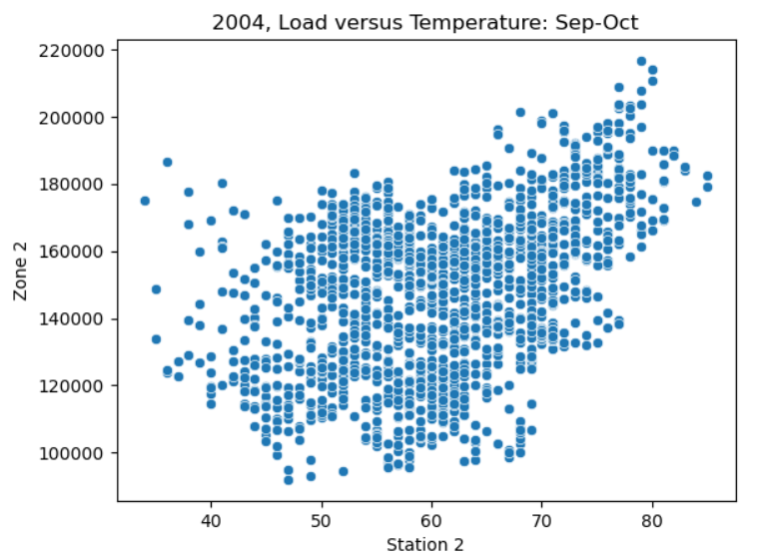
Load – Temperature Relationship (Shoulder Months)

Slide 22
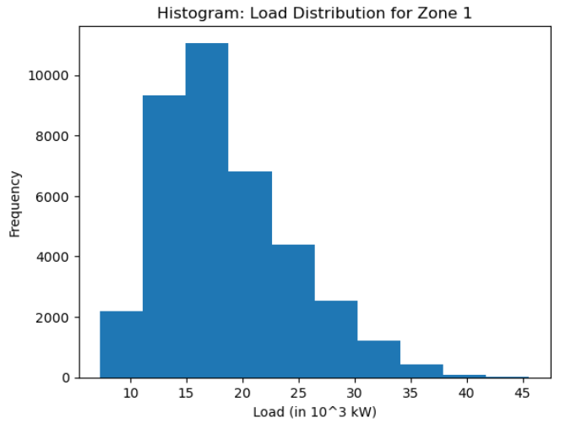
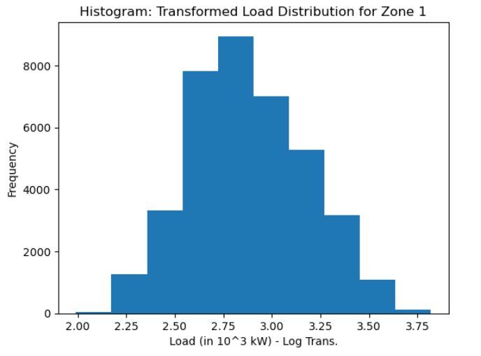
Variance Stabilization on Load – Log Transformation

Slide 23
Methodology & Results

Slide 24
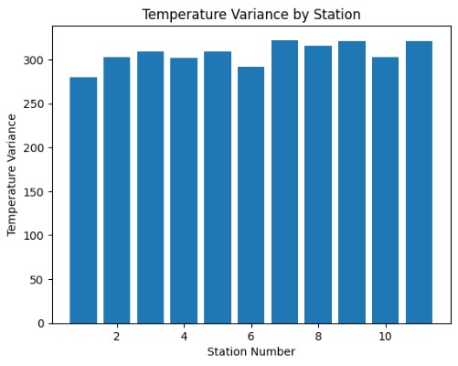
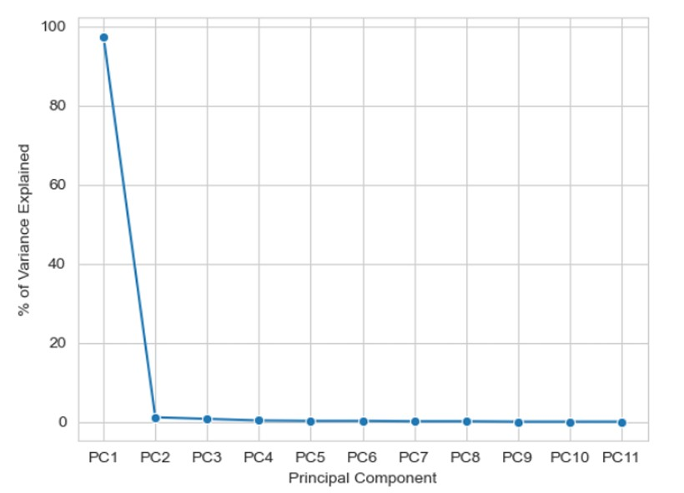
Treatment of Temperature

Slide 25
2004
Jan
Jul
Oct
Dec
Apr
Data Segmentation: Training and Testing
Train
Test

Slide 26
Naïve Methods: Performance Comparison

Slide 27
Method 1
Exponential Smoothing

Slide 28
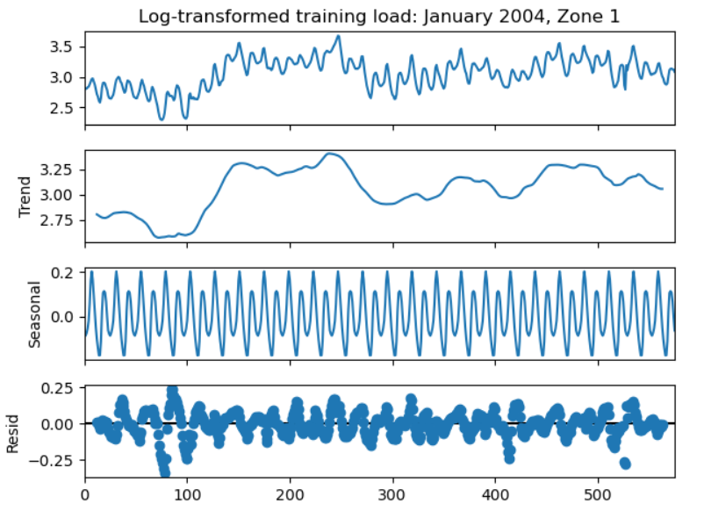
Method 1: Exponential Smoothing

Slide 29
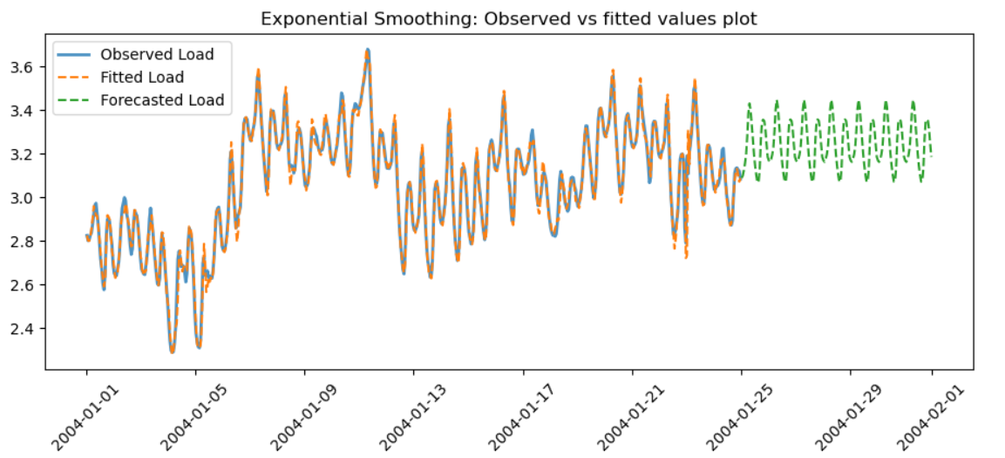
Method 1: Exponential Smoothing (Cont’d)

Slide 30
Method 2
Time Series Regression

Slide 31
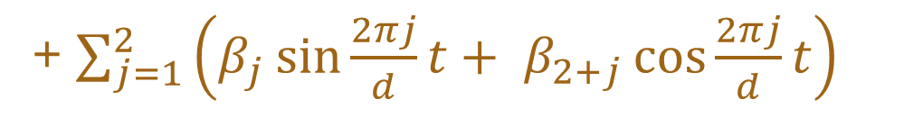
Method 2.1: Harmonic Regression
$E\left(log⁡(y_{t}\right))=β_{0}+β_{t}t$
+ $\sum_{j=1}^{2}{\left(β_{j}\sin{\frac{2πj}{d}}t+ β_{2+j}\cos{\frac{2πj}{d}}t\right)}$

Slide 32
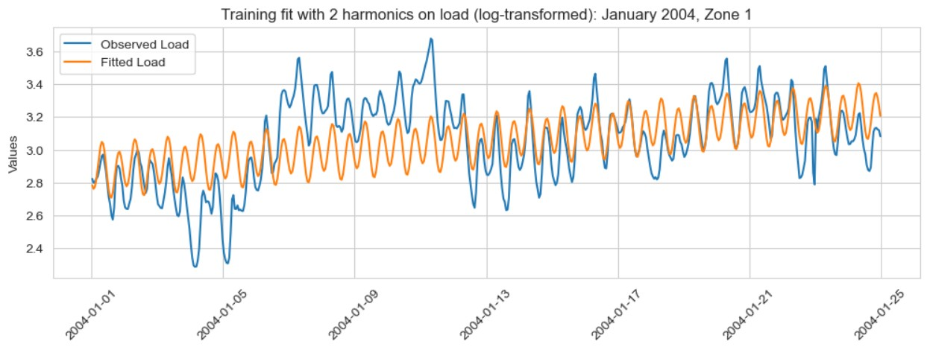
Method 2.1: Harmonic Regression (Cont’d)

Slide 33
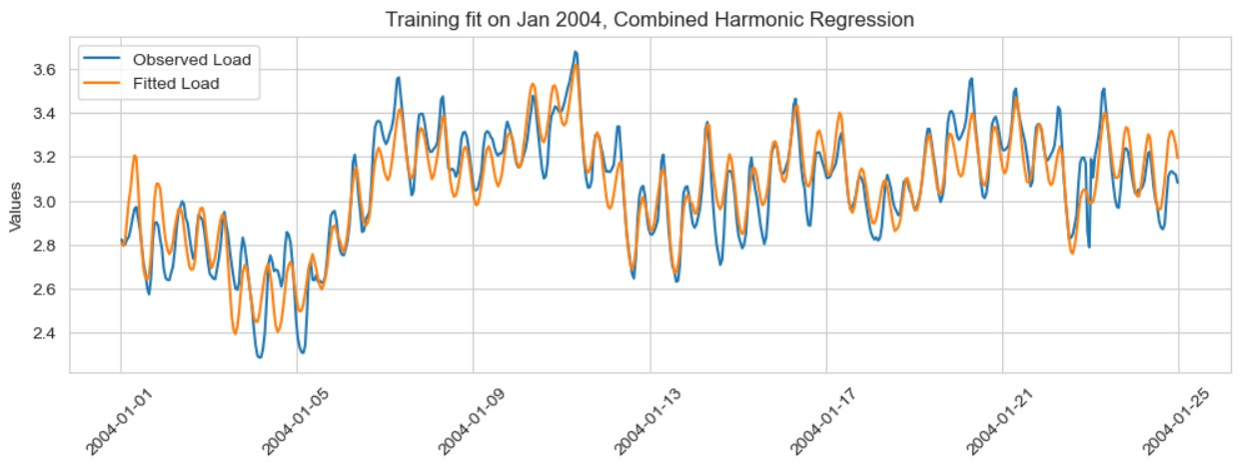
Method 2.2: Harmonic Regression with Temperature

Slide 34
Comparative Analysis (So Far)

Slide 35
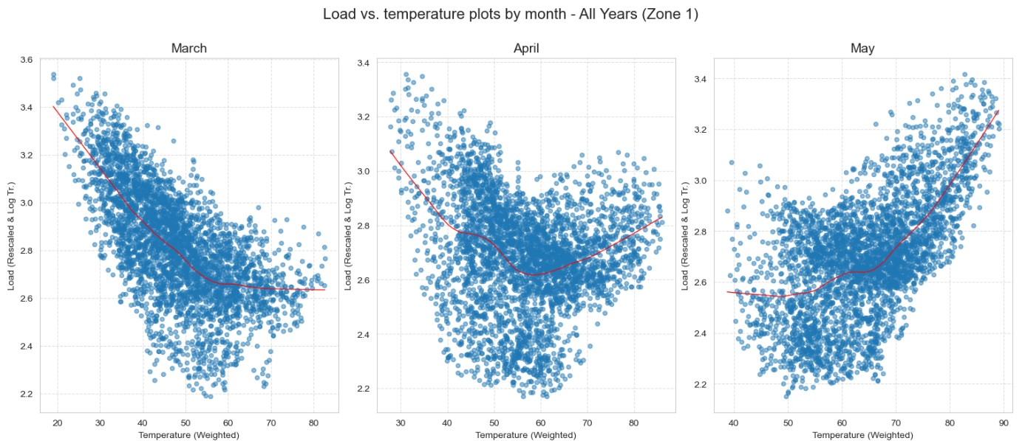
Method 2.3: Piecewise Linear Regression (PLR)

Slide 36
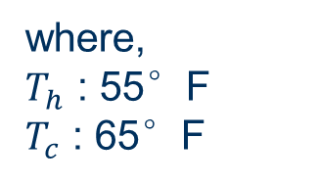
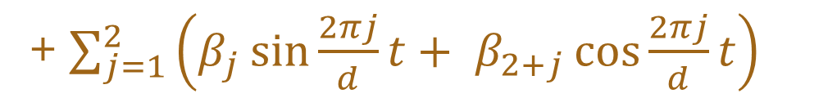
Method 2.3: Piecewise Linear Regression (Cont’d)
$E\left(log⁡(y_{t}\right))=β_{0}+β_{t}t$
$$+ β_{h}\max\left(0, T_{h}−{temp}_{t}\right)+β_{c}\max\left(0, {temp}_{t}−T_{c}\right)$$
+ $\sum_{j=1}^{2}{\left(β_{j}\sin{\frac{2πj}{d}}t+ β_{2+j}\cos{\frac{2πj}{d}}t\right)}$
where,
$T_{h}$ : 55°F
$T_{c}$ : 65°F

Slide 37
Method 2.3: Is Aggregated Performance Improved?

Slide 38
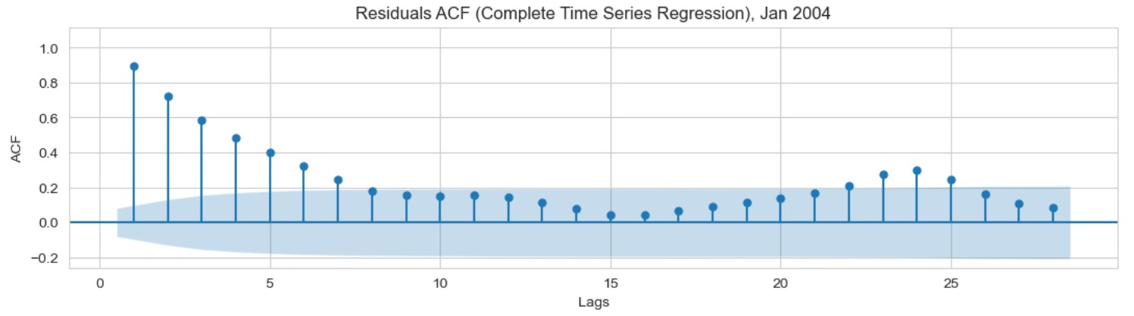
Method 2.3: Piecewise Linear Regression (Cont’d)

Slide 39
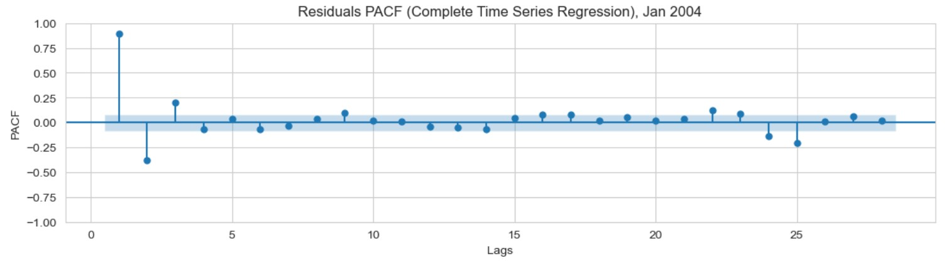
Method 2.3: Piecewise Linear Regression (Cont’d)

Slide 40
Method 3
Seasonal ARIMA(X)

Slide 41
Method 3: SARIMAX
SARIMAX(3,0,0)(1,0,0)[24]
Training Set | Best (p,q) | Best (P,Q) | AIC Value
January, 2004 | (1,1) | (0,0) | -2094
April, 2004 | (3,0) | (2,0) | -2205
July, 2004 | (3,0) | (1,0) | -2636
October, 2004 | (3,0) | (1,1) | -2452
December, 2004 | (3,0) | (0,0) | -2282
Best SARIMA model according to Auto ARIMA, by different training sets

Slide 42
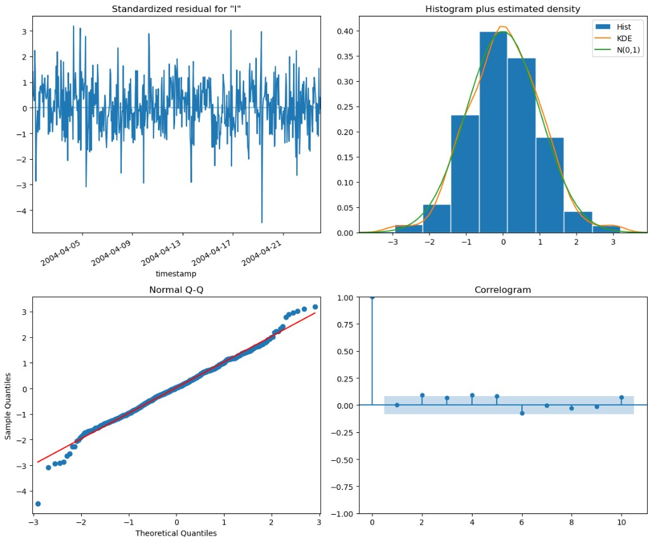
Method 3: SARIMAX(3,0,0)(1,0,0)[24] Diagnostics (Apr 2004)

Slide 43
Comparative Analysis

Slide 44
Missing Values & Forecasting Grid Level Performance

Slide 45
Missing Values (50% vs 60% drop)

Slide 46
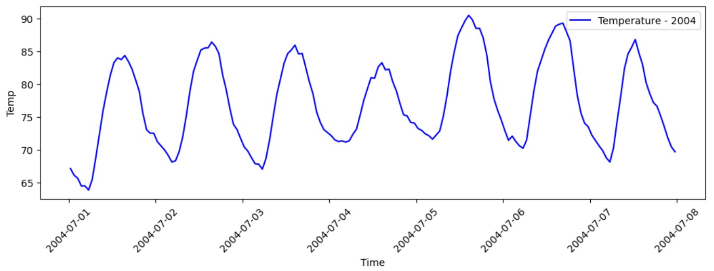
Temperature (1st week, Jul 2004)
SARIMAX(2,1,0)(1,1,0)[24]

Slide 47
Forecasting (30% vs Benchmark)
Overall, 13% improvement over Benchmark (Grid Level)

Slide 48
Thank You For Your Attention!

Slide 49
Appendix Additional Slides

Slide 50
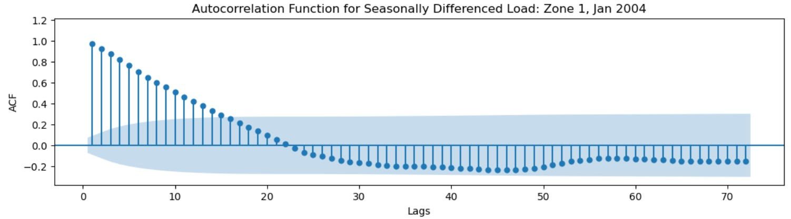
Method 3.1*: Seasonal ARIMA

Slide 51
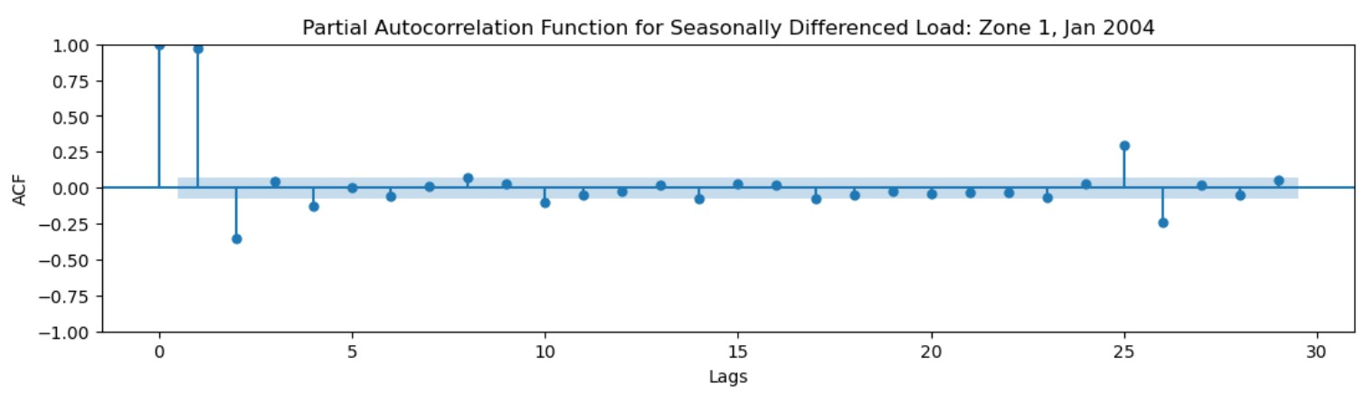
Method 3.1*: Seasonal ARIMA (Cont’d)

Slide 52
Method 3.1*: Seasonal ARIMA (Cont’d)
SARIMA(2,0,1)(2,1,0)[24]
Training Set | Best (p,q) | Best (P,Q) | AIC Value
January, 2004 | (1,1) | (3,0) | -1942.6
April, 2004 | (2,1) | (0,1) | -2068.4
July, 2004 | (1,1) | (3,0) | -2501.0
October, 2004 | (2,1) | (2,0) | -2282.3
December, 2004 | (2,0) | (2,1) | -2386.6
Best SARIMA model according to Auto ARIMA, by different training sets

Slide 53
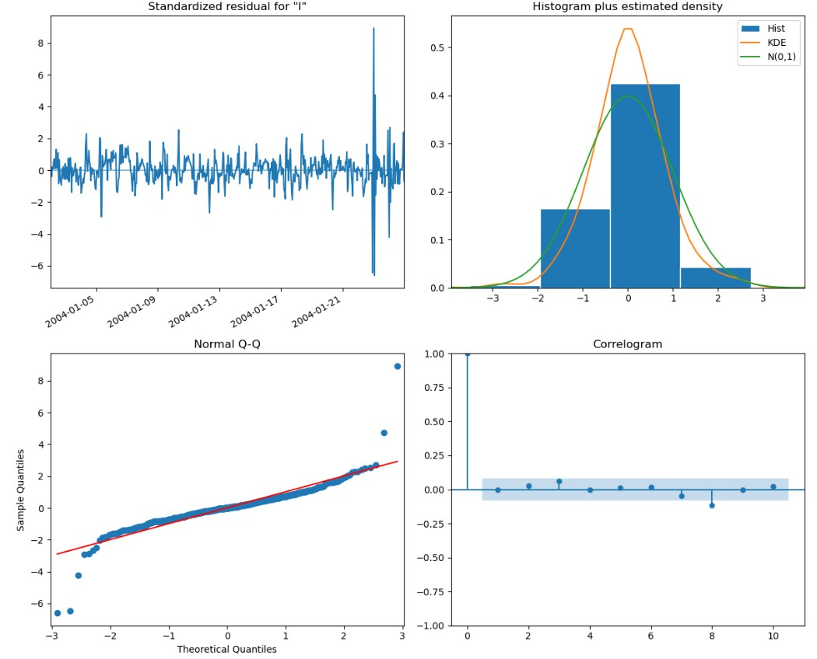
Method 3.1*: SARIMA (2,0,1)(2,1,0)[24] Diagnostics (Jan 2004)

Slide 54
July, 1st week
2004
2006
2007
2005
Test Periods (Temperature Forecasting)
Training: 2 weeks (prior test)

Slide 55
Temperature Forecasting (Relative Performance on Test)

